Slide 1
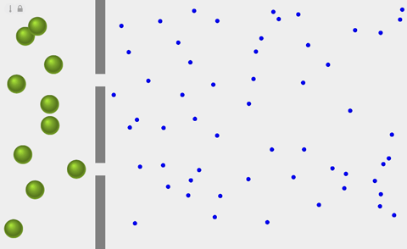
What is Osmosis?
Lesson Objectives:
State the definition of osmosis.
Describe how water moves into or out of a cell by osmosis.
Starter – Five-a-day
Recall the definition of diffusion
Review:
Discuss ideas

Slide 2
Osmosis
Osmosis is the movement of water molecules across a selectively permeable membrane from a region of higher water concentration to a region of lower water concentration
It is a type of diffusion
A partially permeable membrane has very small holes in it – very small molecules, like water, are able to pass through

Slide 3
LO: Know the definition of osmosis
Task
Osmosis is…
A dilute solution means there is more/less water particles, whereas a concentrated solution means there is more/less water particles.
Extension- think and research!
Why do body cells carry out osmosis?
What could happen if cells lost or gained too much water?
Review:
Be prepared to share your ideas

Slide 4
LO: Know the definition of osmosis
Answers
Osmosis is the movement of water across a selectively permeable membrane from an area of high water concentration to an area of low water concentration.
A dilute solution means there is more water particles, whereas a concentrated solution means there is less water particles.
Extension- think and research!
Why do body cells carry out osmosis?
What could happen if cells lost or gained too much water?
Review:
Be prepared to share your ideas

Slide 5
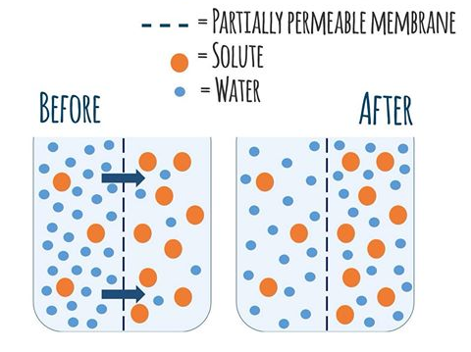
LO: Describe how water moves into or out of a cell by osmosis
Key words
Solute, water, partially- permeable membrane, osmosis, concentrated, dilute, concentration gradient, diffusion
Watch the following video: https://www.youtube.com/watch?v=vCJVXYmXkzM
Describe how the water molecules move across the membrane. (Use the key words)
Review:
Compare against model answers

Slide 6
LO: Describe how water moves into or out of a cell by osmosis
How many marks? (Give 1 mark per point mentioned)
Water molecules move across the partially-permeable membrane by osmosis
Water molecules diffuse across the partially-permeable membrane, by osmosis. The molecules move from an area of high concentration of water to an area of low concentration of water
Water molecules diffuse across the partially-permeable membrane, by osmosis. The water molecules move from an area of high concentration of water (dilute solution) to an area of low concentration of water (concentrated solution). The water molecules move down a concentration gradient.
Review:
Compare against model answers – improve own

Slide 7
Plenary
Quick Quiz
What is diffusion?
What does dilute solution mean?
Define the term solute.
Define the term solvent.
What do we call a membrane that only allows certain particles to pass through it?

